Slide 1
Generative Models & Transformers
GANs, Attention & Transformers

Slide 2
Contents
01
02
What are Generative Models
Introduction to GANs
03
04
Limitations of GAN
What is Self Attention
05
06
Introduction to Transformers
GAN vs Transformers

Slide 3
What Are Generative Models?
Generative models are designed to learn the underlying probability distribution of a dataset, enabling them to generate new data that preserves univariate properties, multivariate relationships, and correlation structures observed in the original data.
What They Learn
What They Generate
Discriminative vs Generative
Data distributions: univariate, multivariate, and correlation patterns
Images, text, audio, and rare-event structured data
Discriminative models classify; generative models learn to produce new samples
In other words, Generative models learn the data distribution and generate new samples that retain statistical properties such as
distributions and correlations.

Slide 4
Introduction to GANs
Generative Adversarial Networks were proposed by Ian Goodfellow in 2014, introducing a revolutionary framework
for generative modeling.
Two Networks
Key Idea: Competition
A Generator and a Discriminator work in opposition to each other
The two networks compete against each other, driving both to improve over time through adversarial training

Slide 5
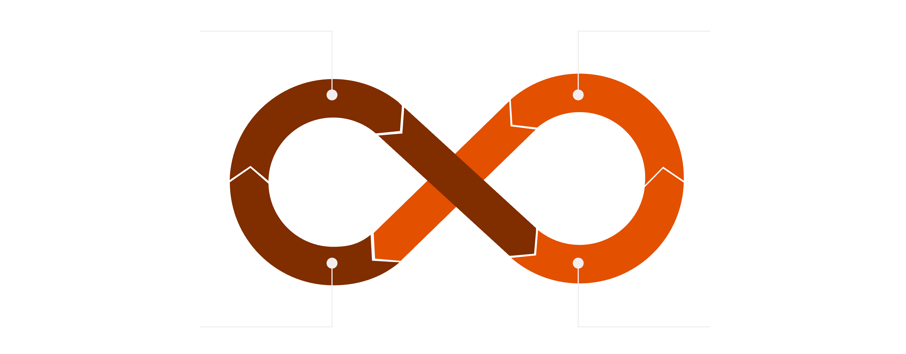
GAN Architecture
Generator Creates Fakes
Discriminator Classifies
Update Networks
Compute Feedback Loss
The Generator produces synthetic samples from random noise, while the Discriminator evaluates whether each sample is real or fake. This feedback loop drives iterative improvement in both networks, until an equilibrium is reached where the generated data becomes indistinguishable from real data and the Discriminator can no longer reliably differentiate between the two.

Slide 6
GAN Architecture

Slide 7
GAN Intuition: Artist vs. Critic
🎨 The Artist (Generator)
🔍 The Critic (Discriminator)
Creates forgeries — fake paintings — trying to make them indistinguishable from real masterpieces. Gets better with every critique.
Examines each painting and tries to spot the fake. Becomes sharper as the artist improves their craft.
Over time, the artist becomes so skilled that even the expert critic can no longer reliably tell the difference — this is the
goal of GAN training.

Slide 8
GAN Training Idea
GAN training is fundamentally an adversarial learning process where two objectives are in direct conflict.
Generator's Goal
Discriminator's Goal
Adversarial Learning
Fool the Discriminator by producing fake samples realistic enough to be classified as real
Detect the Generator's fakes and correctly distinguish real data from synthetic samples
Both networks improve simultaneously through this competition, converging toward a Nash equilibrium

Slide 9
Applications of GANs
Synthetic Structured Data
Image Generation
Deepfakes
Generate realistic tabular or structured datasets for training, testing, and augmenting rare-event scenarios
Create photorealistic images, artwork, and visual content from scratch or from text prompts.
Synthesize highly realistic video and audio of people, raising both creative and ethical considerations
GANs can be used for image enhancement by improving resolution, reducing noise, and reconstructing missing details from low-quality inputs.
They generate sharper, more realistic images by learning fine textures and complex visual patterns.
This is widely applied in medical imaging, surveillance, photography, media restoration, and satellite imaging where visual quality is critical.

Slide 10
GAN Limitations
Training Instability
Mode Collapse
Hard to Tune
The adversarial dynamic can cause training to oscillate or diverge, making convergence difficult to guarantee
The Generator may produce limited types of outputs, failing to capture the full diversity of real data (a problem known as mode collapse).
GANs are hard to train because they are very sensitive to hyperparameters and require careful balance between the Generator and Discriminator.
GANs are powerful but require careful tuning and balance to achieve stable and diverse results.

Slide 11
What Is Attention?
Attention is a mechanism that allows a model to focus on the most relevant parts of an input when producing an output — rather than treating all inputs equally.
Selective Focus
Dynamic Weighting
Human Analogy
The model learns which parts of the input to emphasize, adapting its focus based on context
Similar to how humans focus on key words in a sentence rather than processing every word with equal effort
Not all input tokens or features carry equal importance for a given task or prediction

Slide 12



Attention Mechanism
The attention mechanism operates through three core components that work together to compute weighted
importance across inputs.
Query (Q)
Key (K)
Value (V)
Represents what the model is currently looking for — the "question" being asked of the input
Represents the identifiers of each input element — used to match against the Query
The actual content retrieved — weighted by how well each Key matched the Query

Slide 13
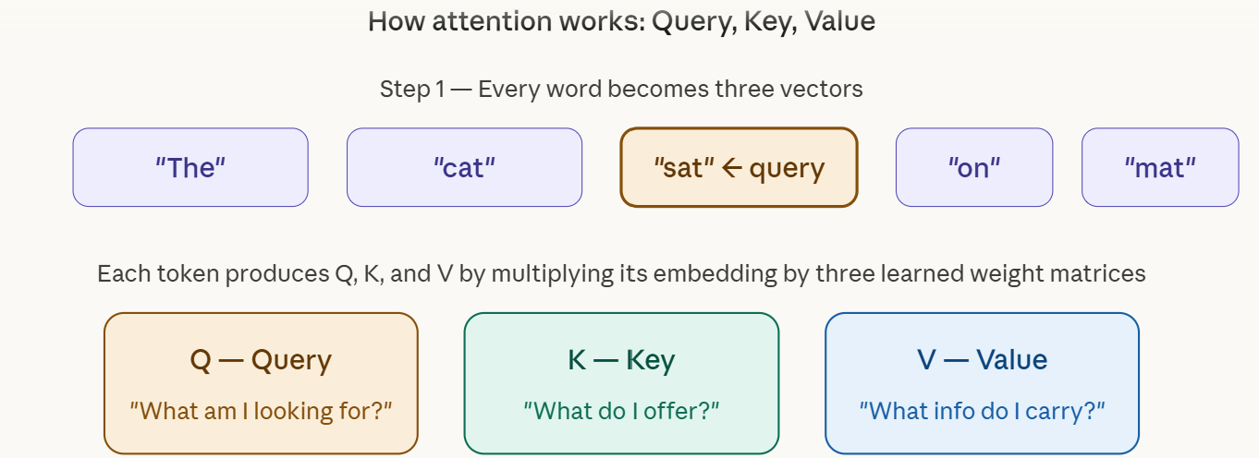
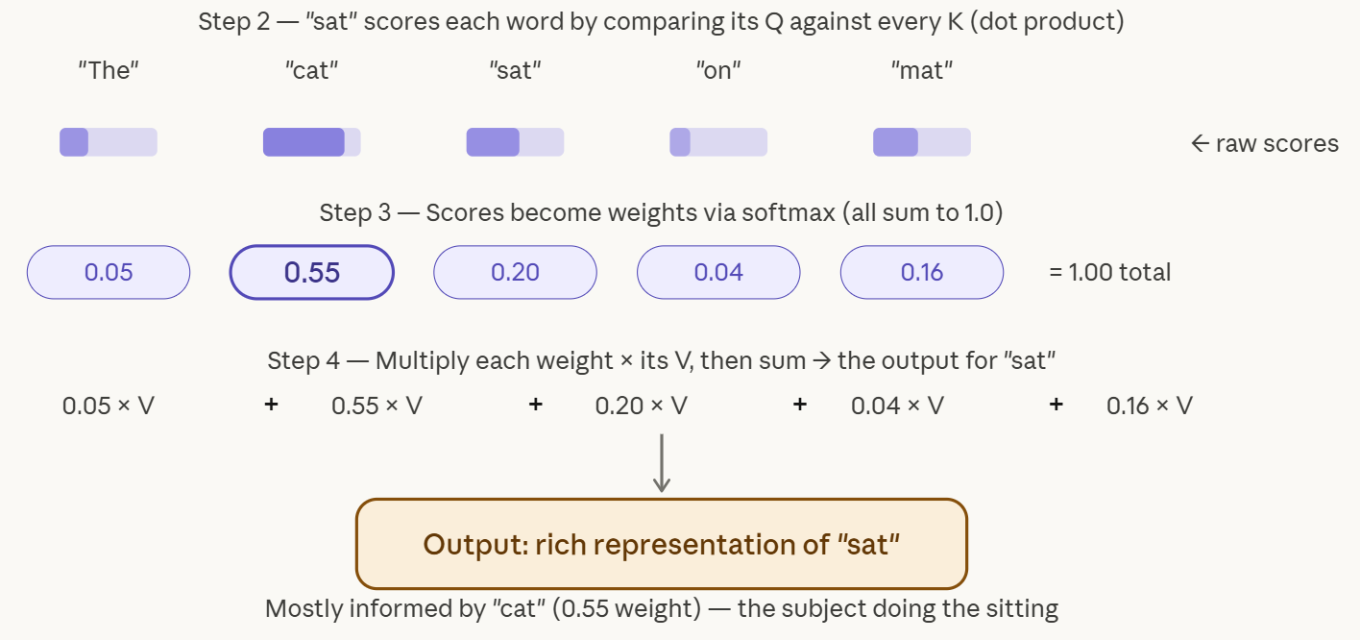
Attention Mechanism - Example
Query — the word currently asking "what should I pay attention to?" ("sat" in this example)
Key — every word advertises what it's about; the query dot-products against all keys to score relevance
Softmax — raw scores become attention weights that sum to 1 (notice "cat" gets 0.55 — it's the subject doing the sitting)
Output — weighted sum of all Value vectors, giving "sat" a rich representation shaped mostly by "cat"

Slide 14
Introduction to Transformers
Transformers are a landmark architecture built entirely on the attention mechanism — replacing recurrent (RNN) and convolutional (CNN) layers entirely.
Attention-Based
No CNN or RNN
Broad Applications
Relies solely on self-attention to model relationships between all positions in a sequence simultaneously
Eliminates sequential processing bottlenecks, enabling massive parallelization during training
Foundational to modern NLP, computer vision, and large-scale AI systems like GPT and BERT

Slide 15
Transformer Architecture
1
Encoder
2
Decoder
3
Self-Attention
Processes the input sequence and builds a rich contextual representation using stacked self-attention and feed-forward layers
Generates the output sequence step-by-step, attending to both its own previous outputs and the encoder's representations
Each token attends to every other token in the sequence, capturing long-range dependencies regardless of distance

Slide 16
GAN vs. Transformer
GAN
Transformer
Adversarial learning framework
Two competing networks: Generator vs. Discriminator
Primarily used for data generation tasks
Training can be unstable and hard to tune
Attention-based architecture
Encoder-Decoder structure with self-attention
Used in NLP, vision, and general AI systems
Highly parallelizable and scalable
Both are powerful generative architectures, but they differ fundamentally in structure, training dynamics, and primary use cases.

Slide 17
Key Takeaways
01
02
Generative Models Learn Distributions
GANs Use Adversarial Competition
They model data distributions to generate new, realistic samples — images, text, audio, and structured data
A Generator and Discriminator compete, driving both to improve — but training instability and mode collapse remain key challenges
03
04
Attention Enables Selective Focus
Transformers Are Attention-Only
Query, Key, and Value components allow models to weight the importance of different inputs dynamically
No RNNs or CNNs — just self-attention and feed-forward layers, enabling scalable, parallelizable AI systems

